Slide 1

HCI - Assignment n.2
Design and prototyping of an application using a human-centered approach
Deliverable n. 3: Final Presentation
Project Title: TaskPad
Group: Daniel Gomes, Mário Silva, Luís Valentim
Lab Class: P6
HCI 2019-2020

Slide 2
Introduction
TaskPad
In Today’s Society, having the ability to do multitasking is fundamental.
However,not everyone can manage its personal tasks, the right way.
People have need to Scheduling activities and events.
Also there’s a need of noting down important tasks on the spot.
Simple Way to do All of This?
HCI 2019-2020
‹#›

Slide 3

Project Objectives
TaskPad
Description
To-Do app that helps users easily keep track of different projects and tasks.
Main Goals
Help people with their daily duties in order to accomplish them in a more efficient way.
Make it simple and straightforward to use.
HCI 2019-2020
‹#›

Slide 4

First Persona
TaskPad
Miriam Coelho
She is 25 years old.
Recently majored in Economics.
Starting her first job, unexperienced in leading team projects.
Wants to be the best Team Leader she can be.
Feels the need of something to help her organize all teams and the tasks of each one has to do.
HCI 2019-2020
‹#›

Slide 5
Miriam’s Scenario
TaskPad
“Got assigned as a Team Leader for a project in the company she works and for that reason, she needs a way to assign tasks and manage all the members of the team. However Miriam doesn’t know much about tools that can help her do it.”
HCI 2019-2020
‹#›

Slide 6
Miriam’s Tasks
TaskPad
Create Several Pages.
Manage Members in a Page.
Create topics per Page.
Each Topic will have several tasks.
Invite Team Members to collaborate.
HCI 2019-2020
‹#›

Slide 7

Second Persona
TaskPad
Leandro Silva
He is 20 years old.
Studying Software Engineering.
Easily forgets both shores and work tasks.
Wants to be more productive and organized.
Searching for a way to conciliate his main tasks, like university projects with the rest of his personal activities (playing videogames with his friends).
HCI 2019-2020
‹#›

Slide 8
Leandro’s Scenario
TaskPad
“Leandro had a rough week at university due to all of the assignments he had thus he forgot to buy groceries and now has to order an expensive takeaway service. He definitely needs something to help him not forget his daily tasks and his university duties.”
HCI 2019-2020
‹#›

Slide 9
Leandro’s Tasks
TaskPad
Set reminders.
Add topic and tasks to it.
Easily access topics.
Remove already done tasks.
Access a calendar to check every topic’s date.
Share his personal page with friends.
HCI 2019-2020
‹#›

Slide 10
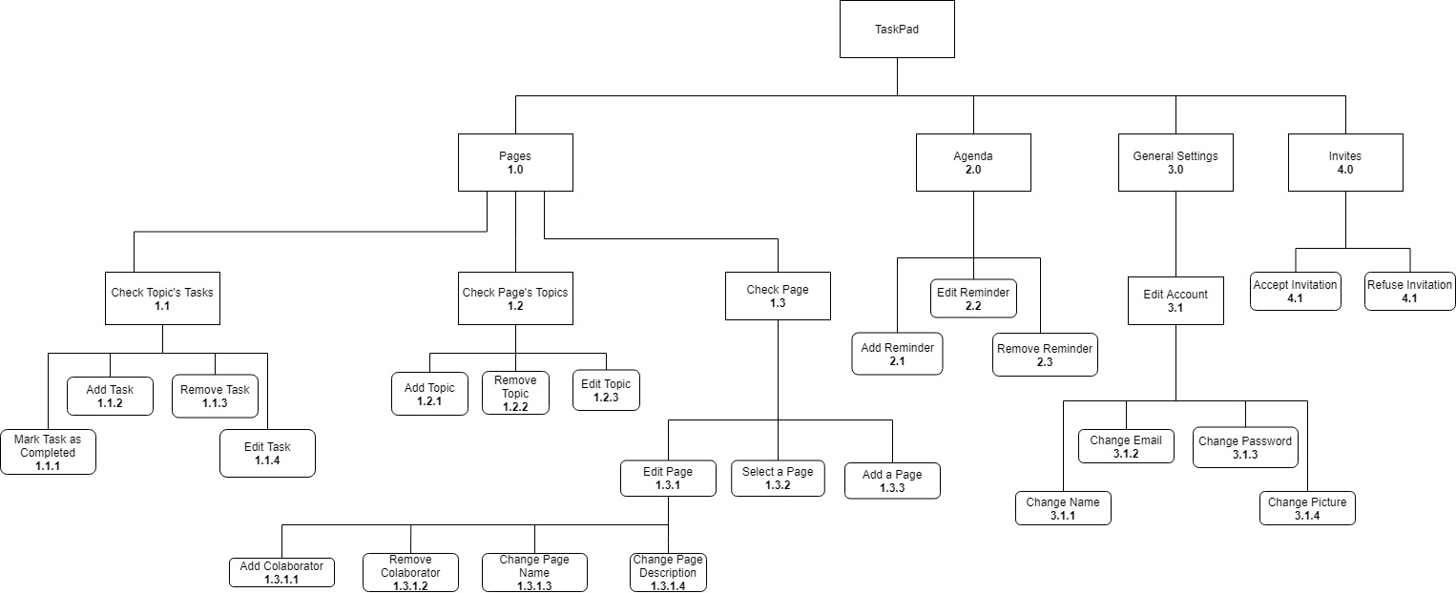
Functional Decomposition Diagram
TaskPad
HCI 2019-2020
‹#›

Slide 11

Non Functional Requirements
TaskPad
Small learning curve.
Simple naming features.
The Design must be pleasant to the user, but minimalistic.
Users should not commit many mistakes while doing their main tasks.
Errors: Help users recover from their errors.
Efficiency: users should reach their goals easily and quickly.
Memorability: users might return to the interface after some time and start efficiently working with it right away.
HCI - 2019-2020
‹#›

Slide 12
Functional Requirements
TaskPad
Have a personal page.
Create projects pages.
Invite people to pages.
Create, change and delete topics and tasks of a page.
Have a personal agenda of reminders.
Easy to separate topics.
Well adapted to mobile.
HCI - 2019-2020
‹#›

Slide 13

LFP User Evaluation
TaskPad
Usability Tests
Our tests mainly focused on sitting next to the participants and taking notes of their behaviour while doing the Use Cases.
After this, we asked and took notes of the participants feedback.
Use Cases:
A - Create a page with the name “Uni Page”.
B - Invite the user “user2” to that page.
C - Create a topic called “IHC” and then add the task “ Make the prototype”.
D - Add a Reminder with the Note “Buy Groceries” in the Agenda
HCI 2019-2020
‹#›

Slide 14
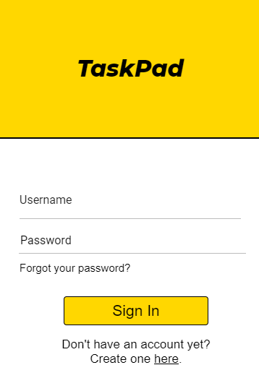
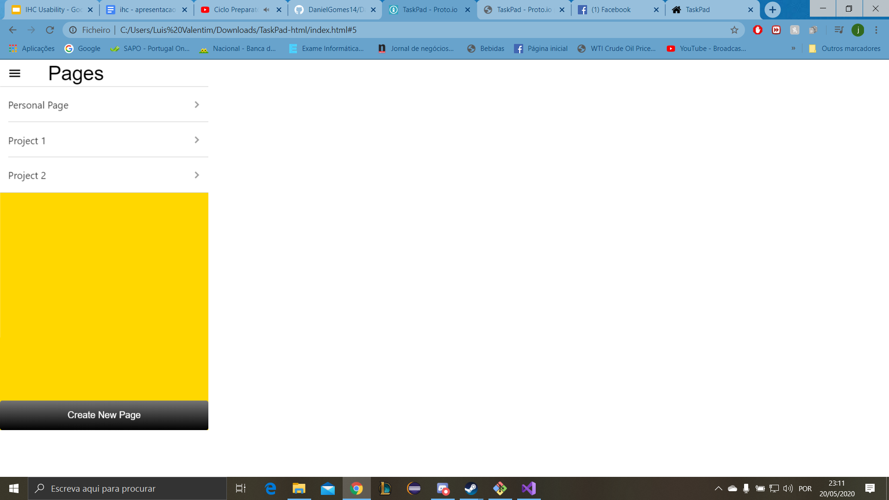
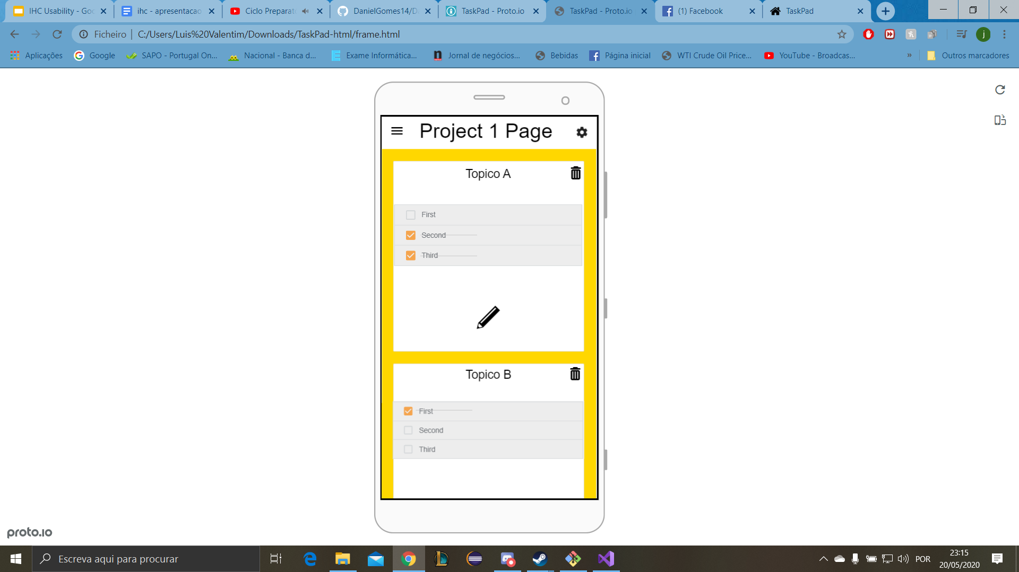
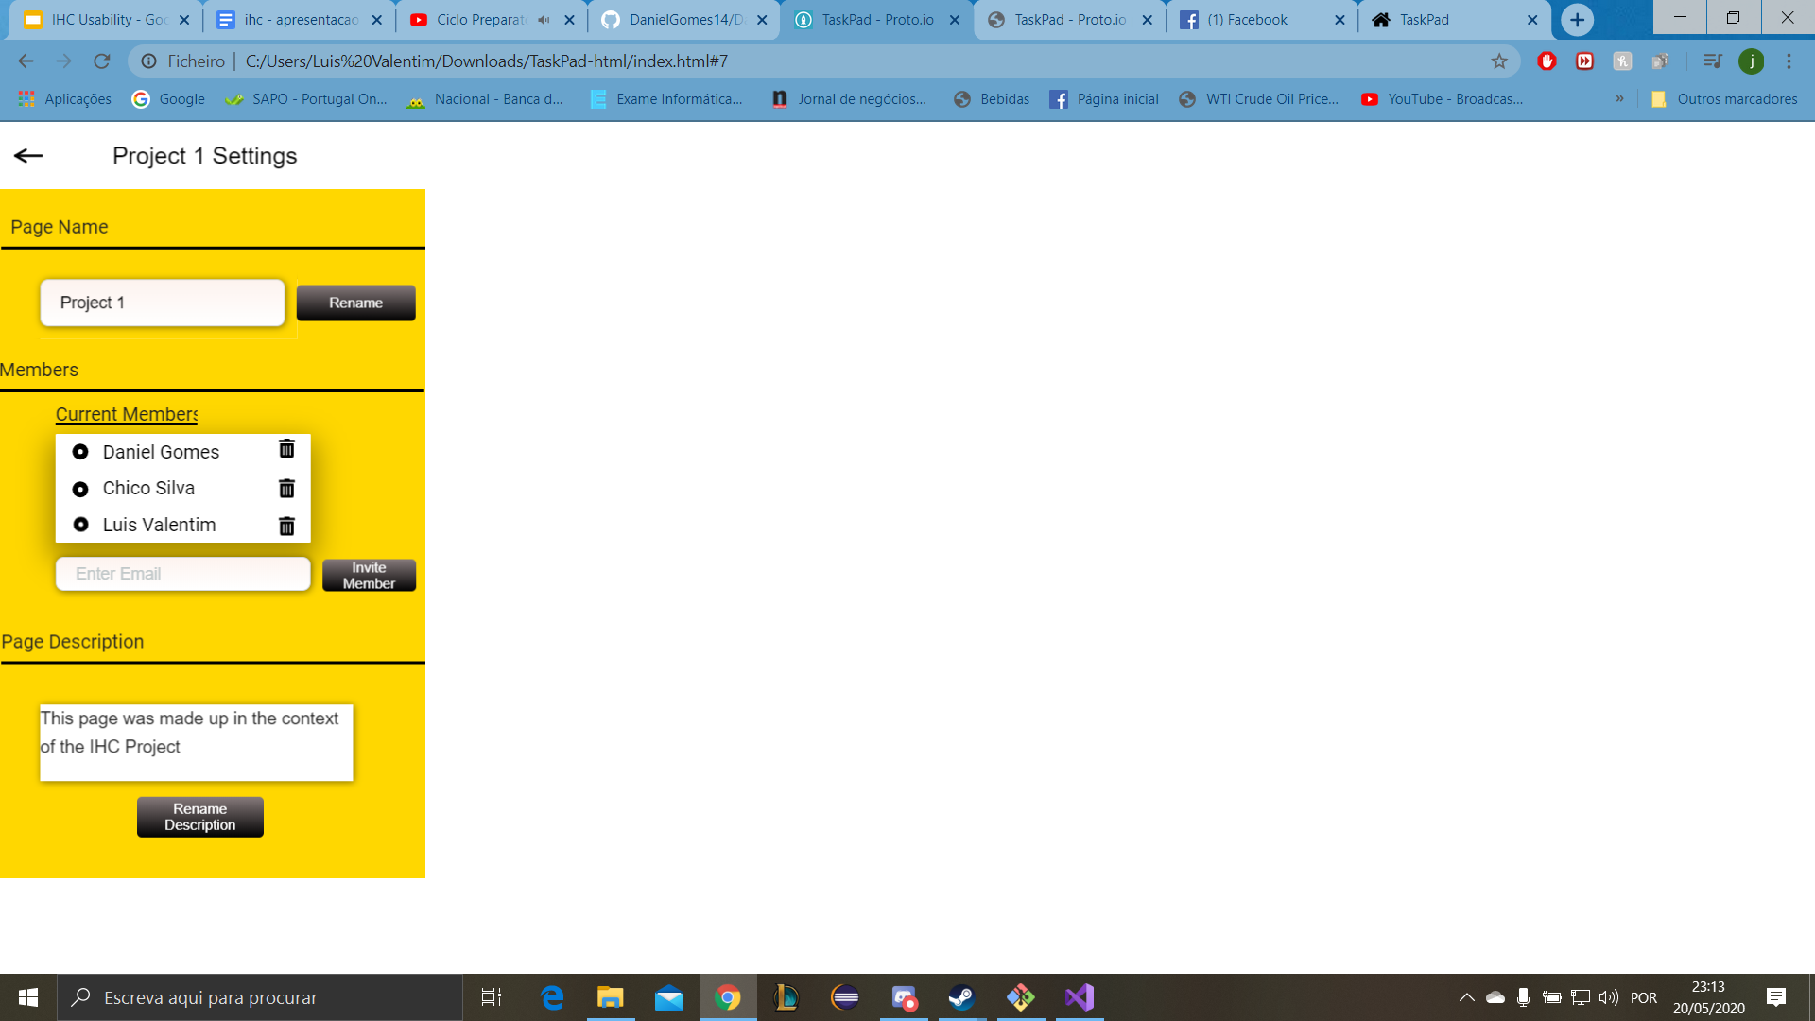
Low Fidelity Prototype
TaskPad
HCI 2019-2020
‹#›

Slide 15
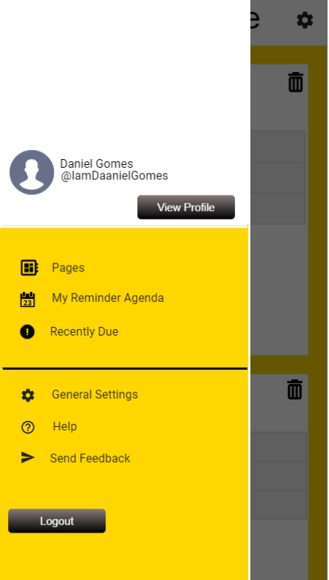
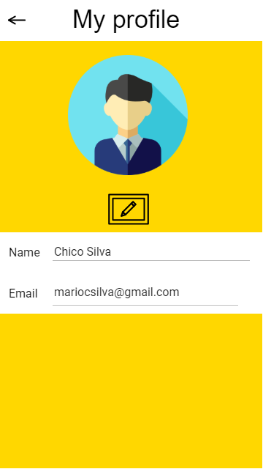
Low Fidelity Prototype
TaskPad
HCI 2019-2020
‹#›

Slide 16
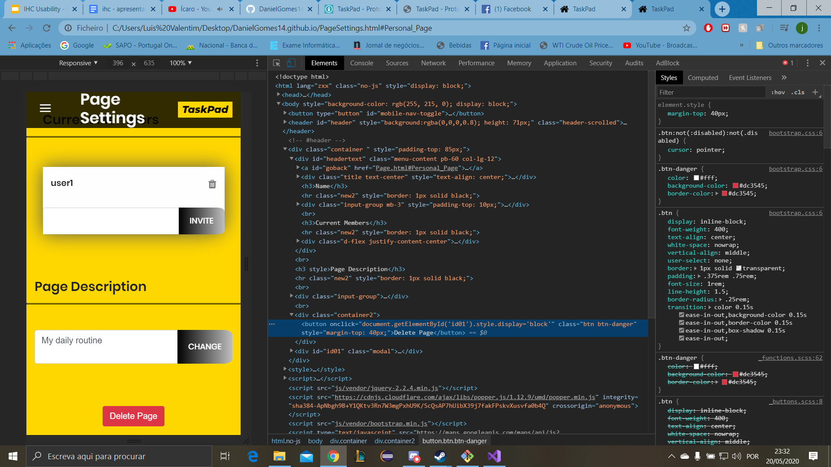
LFP User Evaluation - Changes Made
“Não existe a opção de remoção de páginas”
Before
After
HCI 2019-2020
‹#›

Slide 17
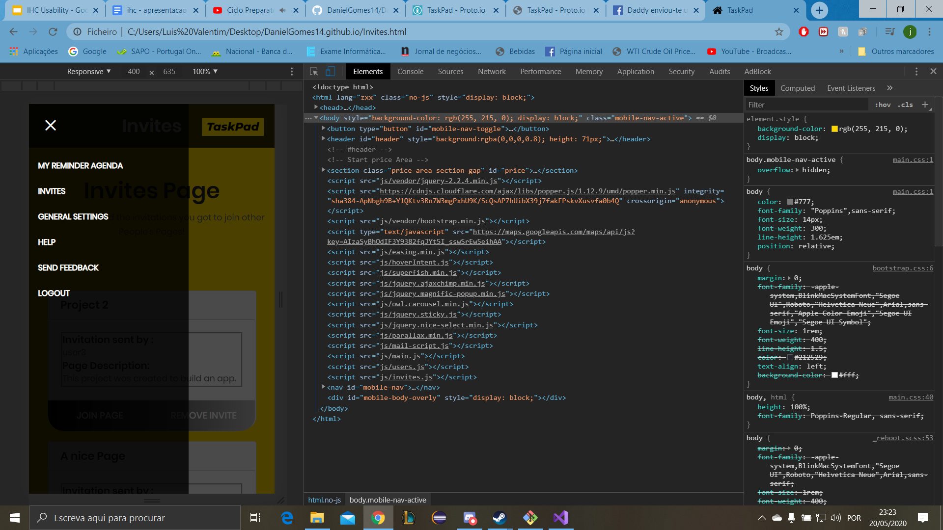
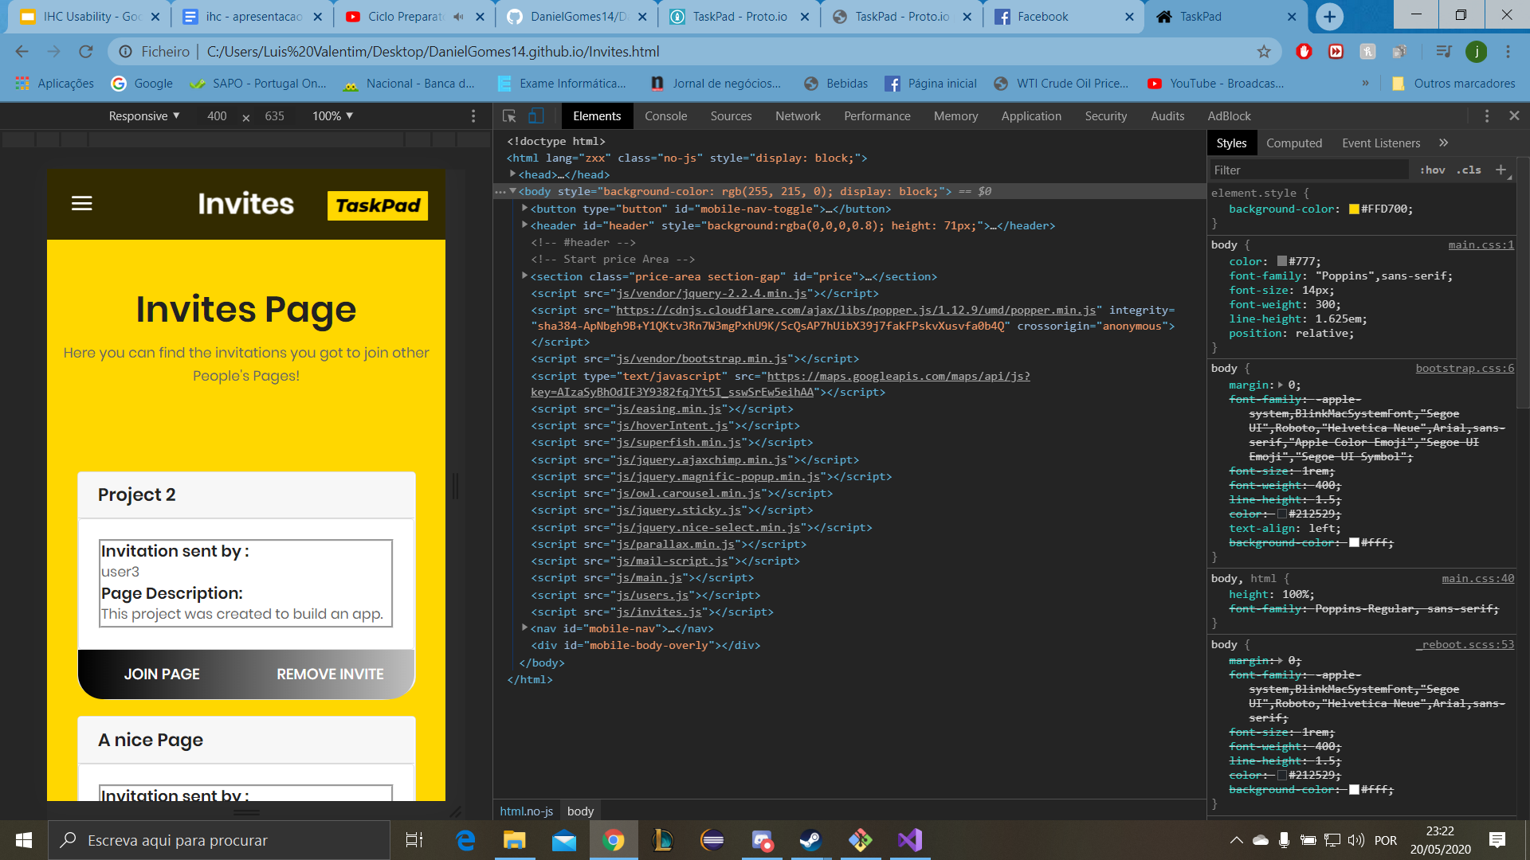
LFP User Evaluation - Changes Made
“Não dá para ver os convites que recebemos”
Before
After
HCI 2019-2020
‹#›

Slide 18
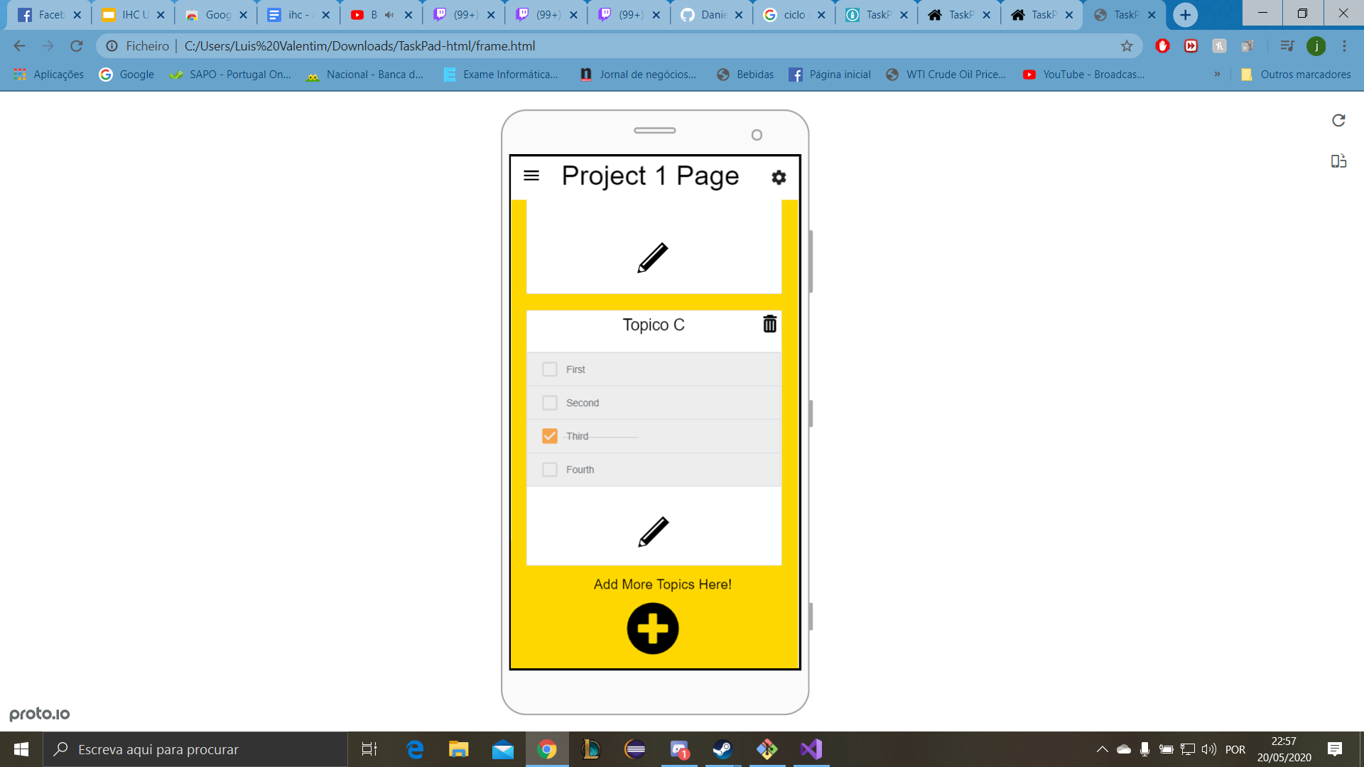
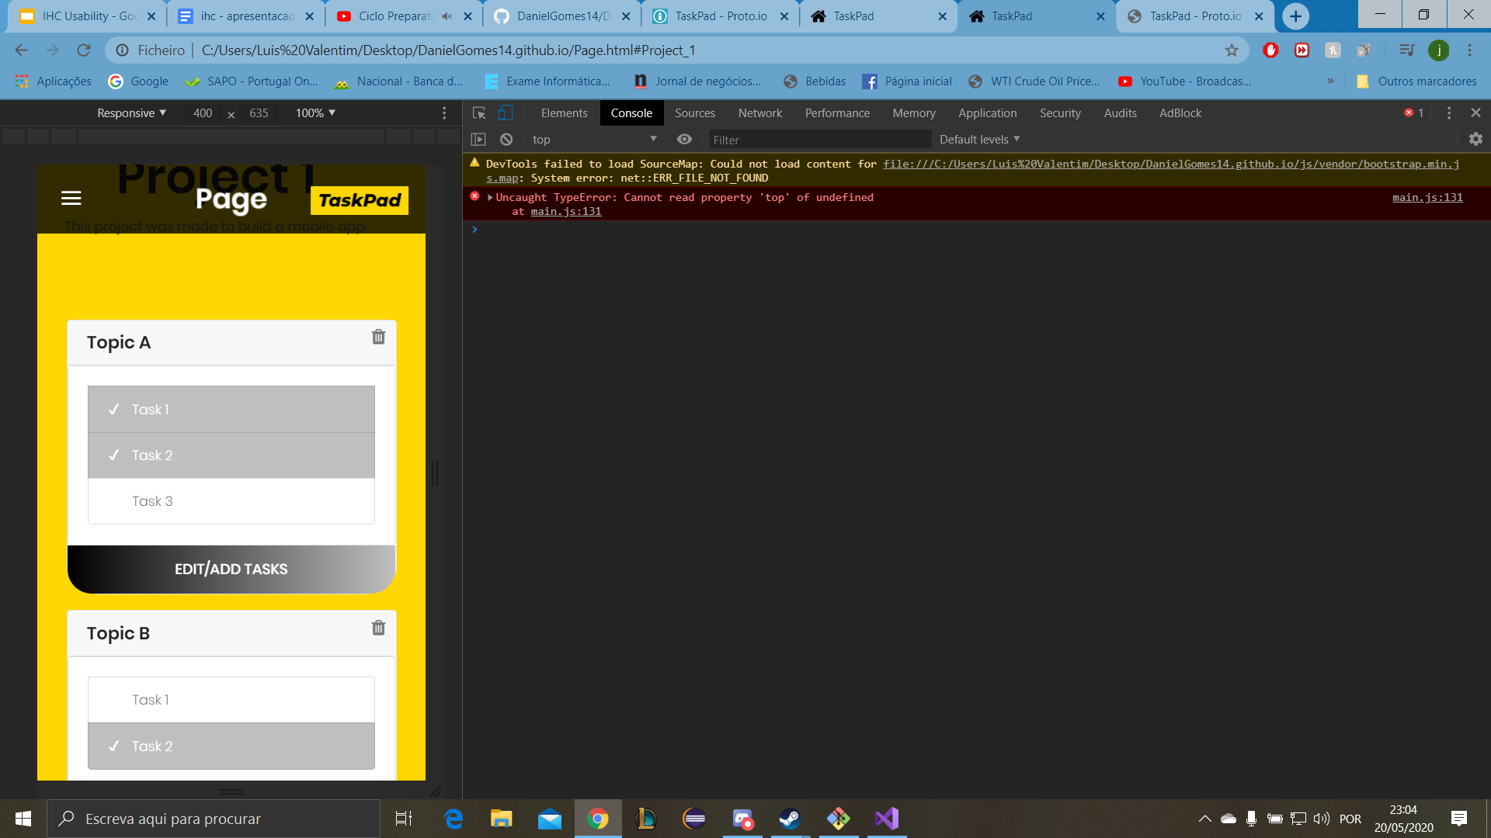
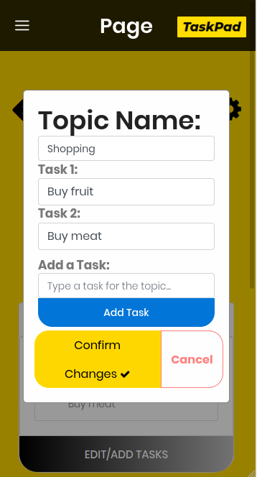
LFP User Evaluation - Changes Made
“Para adicionar tarefas é preciso pressionar no botão de editar o Tópico, o que não é explícito”
Before
After
HCI 2019-2020
‹#›

Slide 19



Platform Used for the Functional Prototype
TaskPad
HTML5,CSS and JavaScript
Frameworks: JQuery and Bootstrap
GitHub and Visual Studio
HCI 2019-2020
‹#›

Slide 20
User Evaluation of the Functional Prototype
TaskPad
Usability Tests
For this evaluation we used the same strategy and use cases used on the LFP since we noticed they were pretty important.
We also created a post questionnaire on Google Forms for the participants to increase the received feedback.
Use Cases:
A - Create a page with the name “Uni Page”.
B - Invite the user “user2” to that page.
C - Create a topic called “IHC” and then add the task “ Make the prototype”.
D - Add a Reminder with the Note “Buy Groceries” in the Agenda
HCI 2019-2020
‹#›

Slide 21
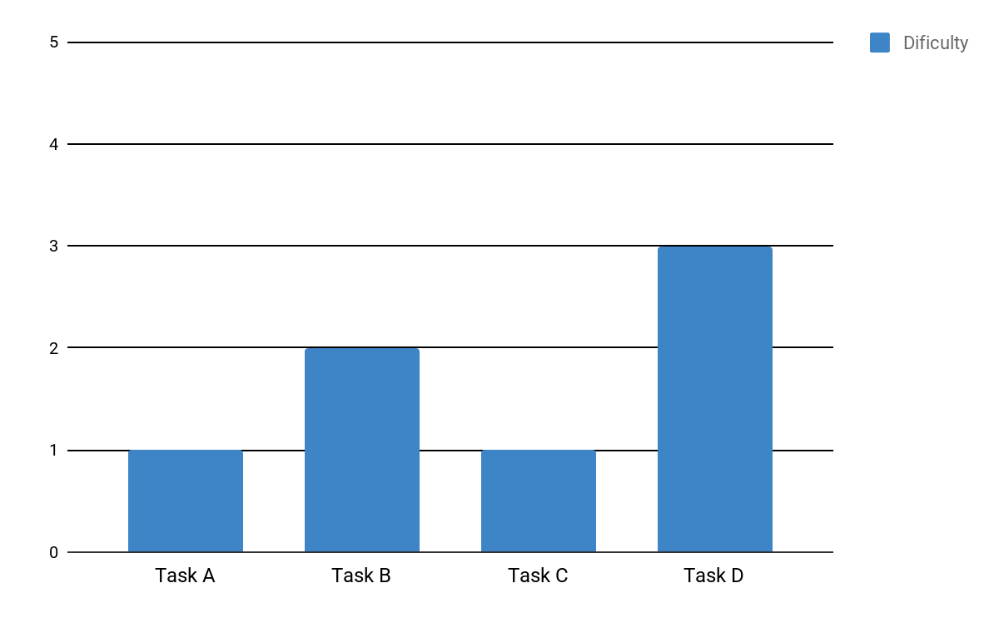
Usability Tests - Results
HCI 2019-2020
‹#›

Slide 22
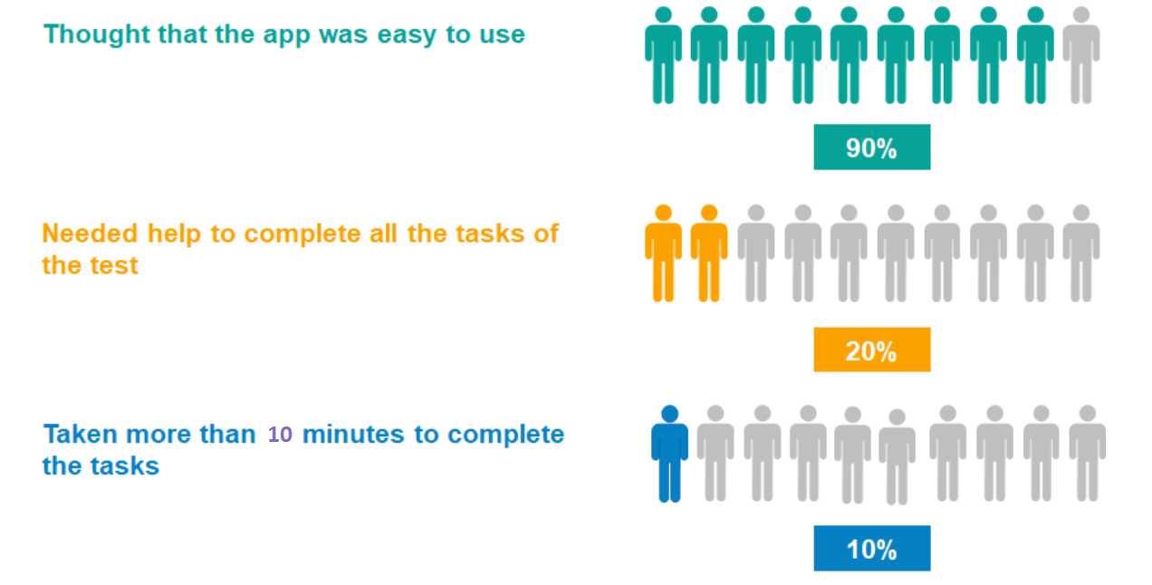
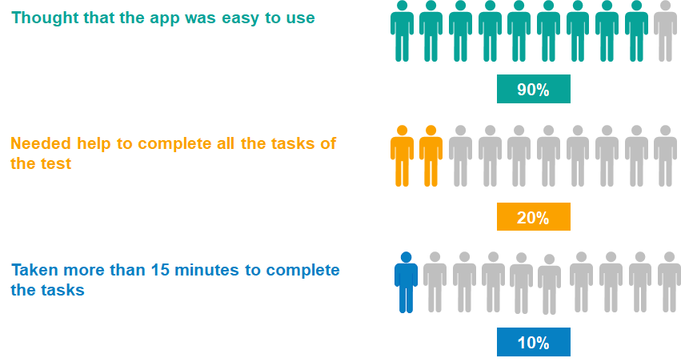
Usability Tests - Results
HCI 2019-2020
‹#›

Slide 23
Post-Tasks Questionnaire
System Utilization | Main Opinion
I would use this app on a daily basis | Agree
The system is easy to use | Totally Agree
The app is complex | Totally Disagree
I would need technical support to use this app | Totally Disagree
The app is inconsistent | Totally Disagree
The app has a big learning curve | Totally Disagree
I felt confidant using this app | Agree
I found the design minimalist | Agree
HCI 2019-2020
‹#›

Slide 24
Heuristic Evaluation
Issue | User 1 | Severity | User 2 | Severity | User 3 | Severity
The buttons do not have a cursor pointer. |  |  | x | 1
The Agenda does not have an Edit Button. | x | 1 | x | 1 | x | 2
Editing profile opens a complete new browser tab. | x | 2 | x | 2 | x | 2
The modal boxes did not clean the values of the input boxes. | x | 3 | x | 3 | x | 2
The buttons “Confirm Changes” and “Add task” should have more space between them. |  |  |  |  | x | 1
“Send FeedBack” has a Loading Glitch. | x | 1 | x | 2 | x | 2
Missing better validation of Agenda Modal Box | x | 1 | x | 2
HCI 2019-2020
‹#›

Slide 25

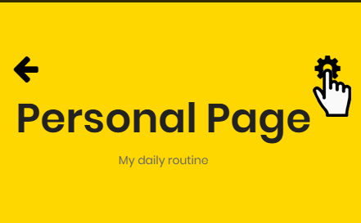
LFP User Evaluation - Changes Made
Added Cursor Pointer to the buttons
HCI 2019-2020
‹#›

Slide 26
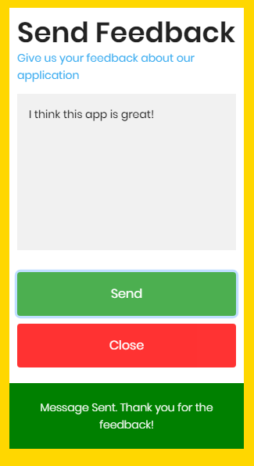
LFP User Evaluation - Changes Made
The “Send Feedback” sending button, Now Notifies the User.
HCI 2019-2020
‹#›

Slide 27
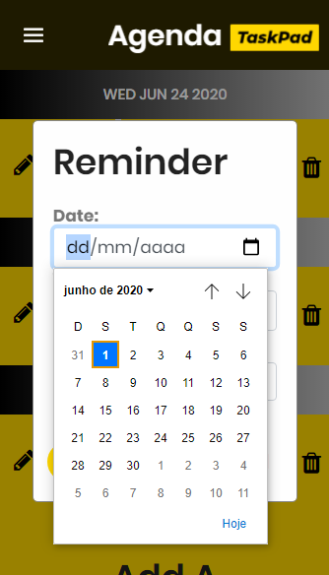
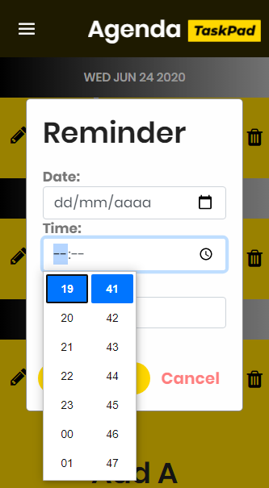
LFP User Evaluation - Changes Made
Added Date Picker and Hour Picker to the Agenda Modal Box and an Edit Button
HCI 2019-2020
‹#›

Slide 28
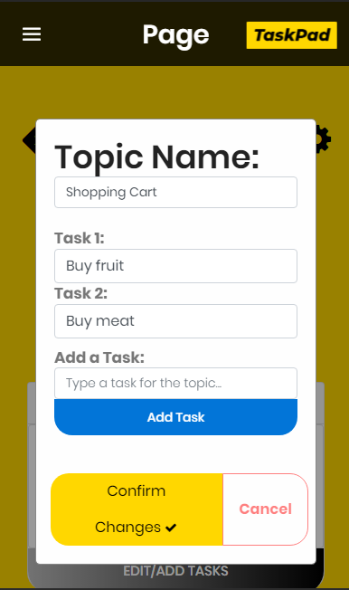
LFP User Evaluation - Changes Made
More space between the buttons “Confirm Changes” and “Add Task”
Before
After
HCI 2019-2020
‹#›

Slide 29
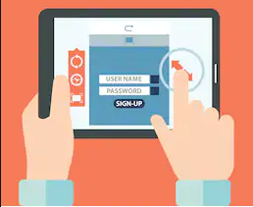

Demo
TaskPad
HCI 2019-2020
‹#›

Slide 30
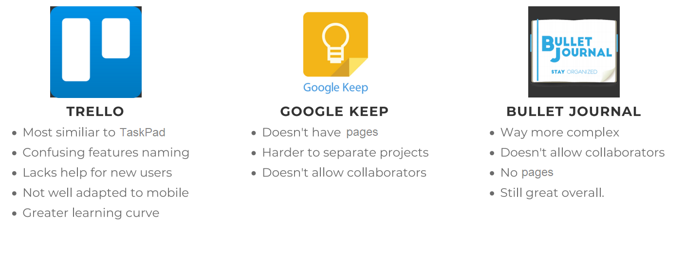
Similar Applications and why ours is better
TaskPad
HCI 2019-2020
‹#›

Slide 31
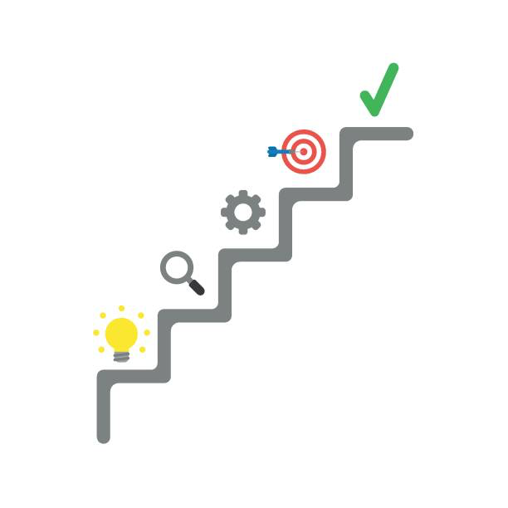
Future Work
Taskpad
If we had more time we would like to:
Have verifications of all user’s input.
Implement a pagination system where we would only allow about six ‘’cards’’ per page.
Add a calendar on the Agenda page to make it more visually appealing and easier to see the reminders of each day.
Have customizable settings of notifications and alarms accordingly to each reminder.
Create a “real” database for our HFP.
HCI 2019-2020
‹#›

Slide 32
Acknowledgments
We are grateful for everyone who participated in our tests and helped us reach our goal!
Effort of each group member
Daniel Gomes - 33%
Mário Silva - 33%
Luís Valentim- 33%
HCI 2019-2020
‹#›

